Slide 1

Automation Testing
-By
Ashritha Y Bhat
13049

Slide 2
Contents
Manual Testing
Automation Testing
Performance Testing
Big Picture
Reference Links

Slide 3
Manual Testing
Swag labs demo site: https://www.saucedemo.com/
By referring the given User stories created Test plan, Test scenario and Test cases (including negative scenarios).
In Jira created project called Swag labs and added Version, Epic, User stories, Sprint, imported test cases, created Cycle summary then executed the test cases manually and update the result in Jira along with the documentation.
Raised defect in Jira and created Defect sheet and RTM.

Slide 4
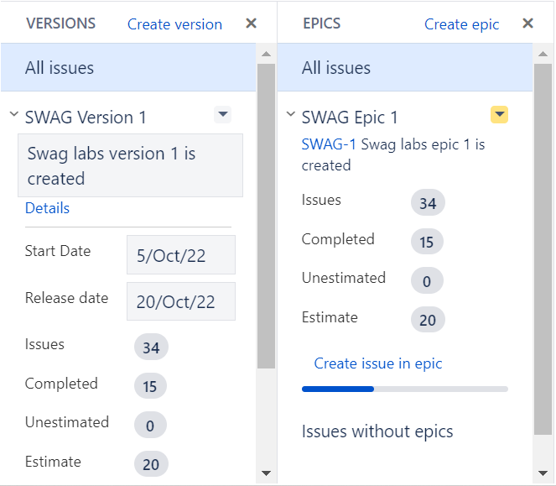
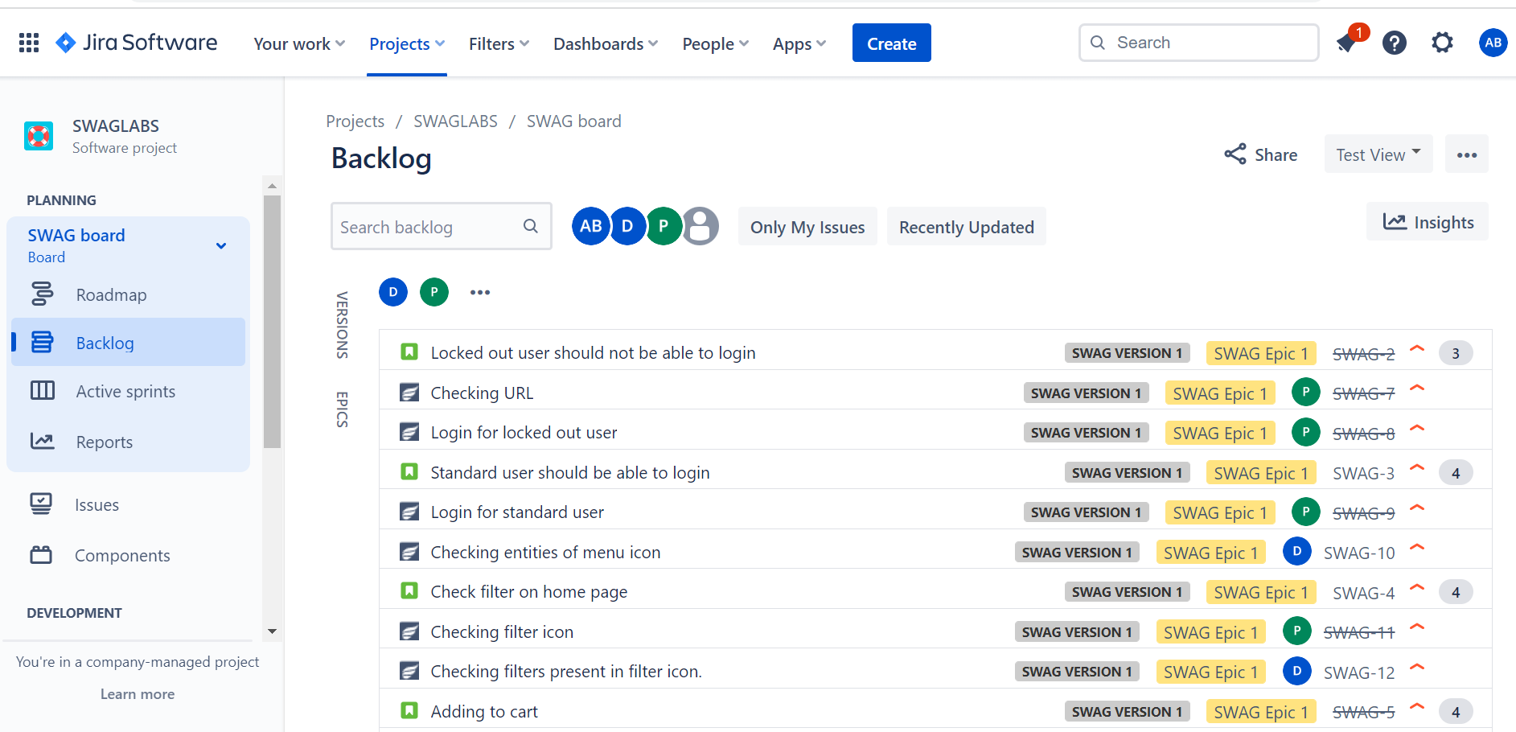
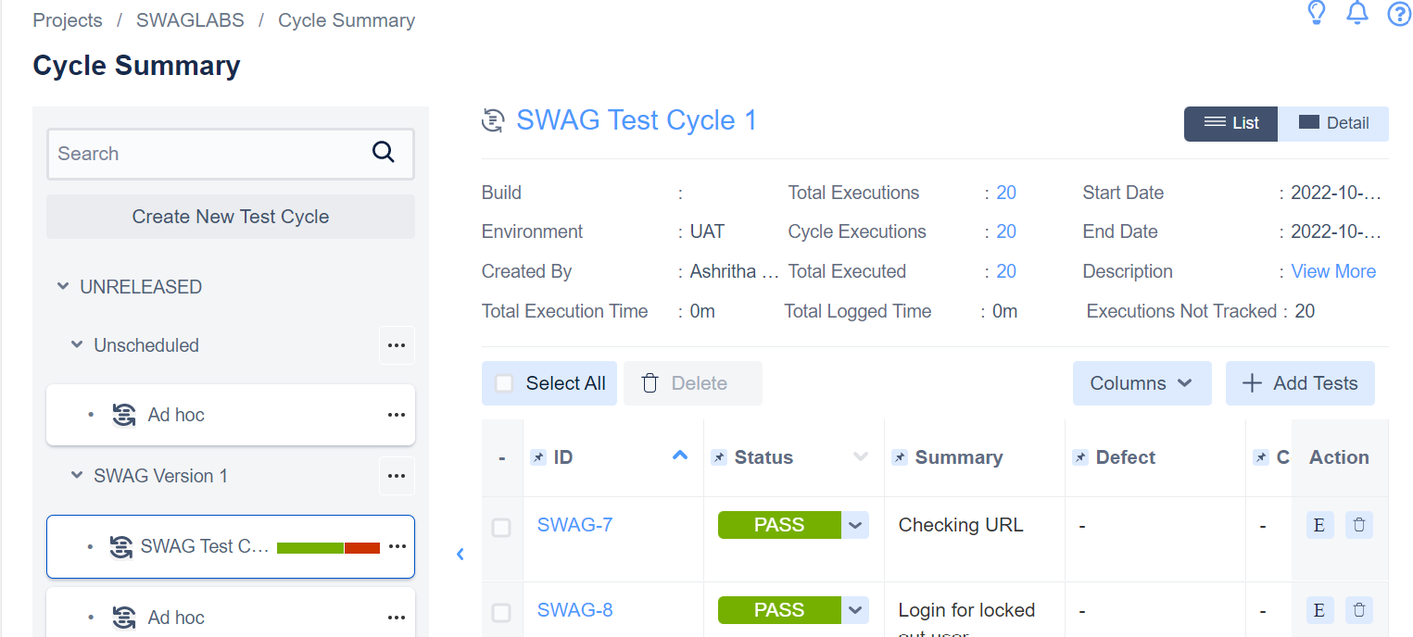
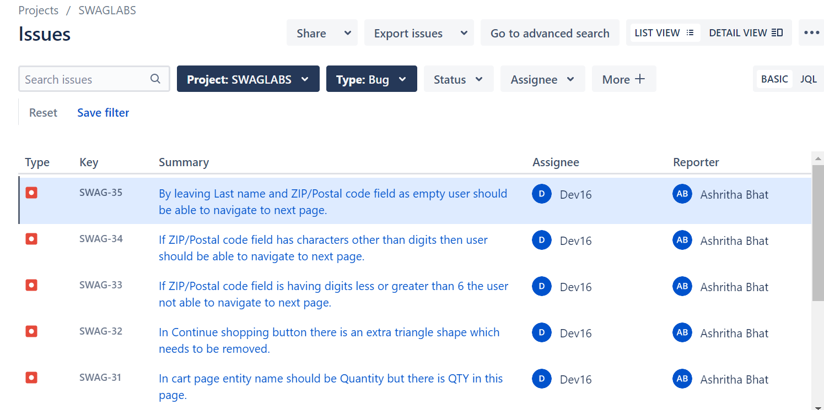

Slide 5
2. Automation Testing
By using Selenium automated Orange HRM Site for login page elements and dashboard elements -https://opensourcedemo.orangehrmlive.com/web/index.php/auth/login
Performed mouse actions for this site - https://demoqa.com/buttons
Performed Alert for this website - https://demo.automationtesting.in/Alerts.html
Wrote a program to HRM Login, apply leave and Searching employee using method overloading in TestNG Framework.
Object Oriented Programming: Wrote programs on these topics: Override, Overloading, Inheritance, Abstract, Interface, Exception Handling, Collections, Access Modifiers.
Wrote a program to HRM Login, apply leave and Searching employee in Cucumber.

Slide 6
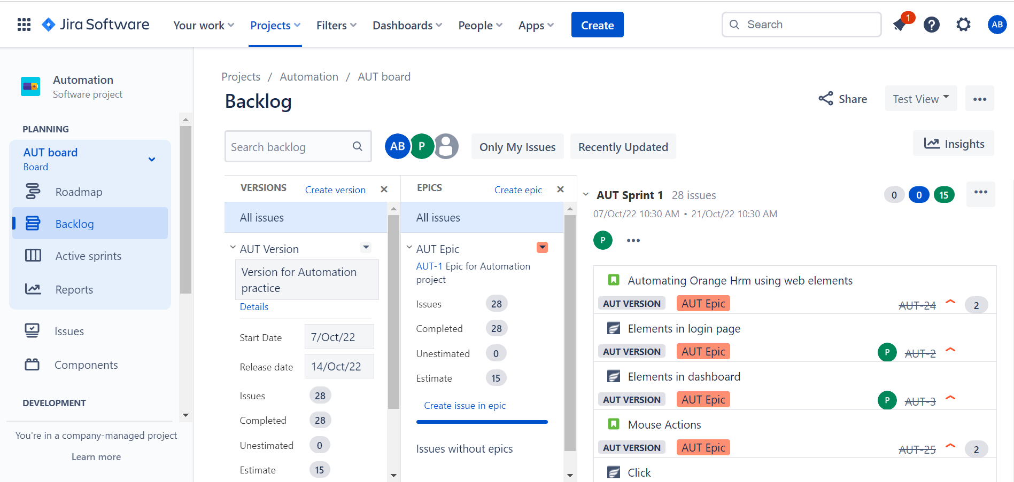
Created test cases for Automation in Jira.

Slide 7
Performance Testing
Performed 2 rounds of load testing with 25 users on Orange Hrm application using JMETER.
4. Big Picture
Created big picture based on my understanding of complete testing concept.

Slide 8
Reference Links:
Drive link:
https://drive.google.com/drive/folders/19v7C6okZYGjAYX3DFYQJ45Et0FV4Nzec?usp=sharing
Blog link:
https://medium.com/@yashrithabhat164/my-first-job-3d7b66eec8f3
Git hub link:
https://github.com/ashrithabhat?tab=repositories
Query and Presentation tracker:
https://docs.google.com/spreadsheets/d/1zjPpVvTMyOk6vIBMI8SleL786OnncIINh3umBogWxFQ/edit#gid=0

Slide 9
Thank you

